Slide 1
Sugon Disk System DS600-G20 Overview
Storage Product Department

Slide 2
Contents
1
DS600-G20 Overview
2
DS600-G20 Administration Configuration
3
DS600-G20 Maintenance
4
DS600-G20 FAQ
Notes:
先讲整个IT行业的大背景

Slide 3
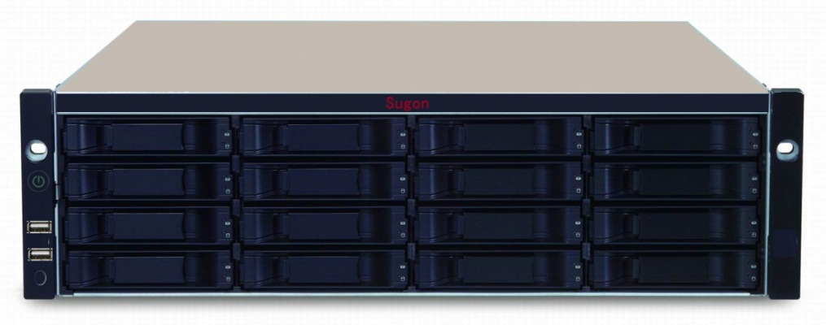
Product Features and Highlights
SYSTEM & CONTROLLER
64bit 6-core @ 1.1GHz Processor
Standard 2GB cache per controller (up to 16GB)
Fiber Channel 8Gbps, iSCSI 1Gbps & 10Gbps host connect ports
Dual Controller High Availability Design
High Scalability (112 HDDs) and Green Design
DATA PROTECTION
Predictive Data Migration (PDM)
PerfectRebuild - Rebuild with improved recovery efficiency
Advanced battery flash backup
Online LUN clone (available in SR1)
Hard disks cache backup (available in SR3)
NAS function
CIFS (MAC, Windows), NFS (Linux/Unix) Protcol
Permission Management, Quota Management, Online Expansion
MANAGEMENT & OPERATION
Power button and power resume management
PerfectFlash™ -Non-disruptive image update without system downtime
Built-in performance monitor and power usage monitoring
OPAS Service Log and UPS Monitor through USB
Support Wake-on-LAN and Wake-on-SAS
Mute alarm control
Notes:
先讲整个IT行业的大背景

Slide 4
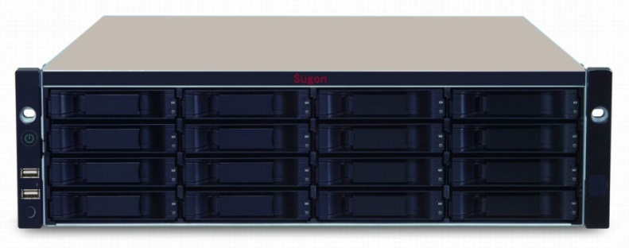
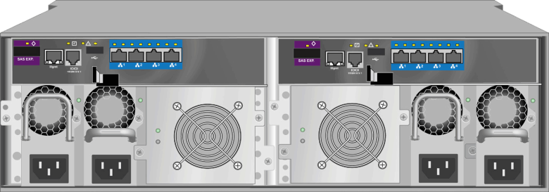
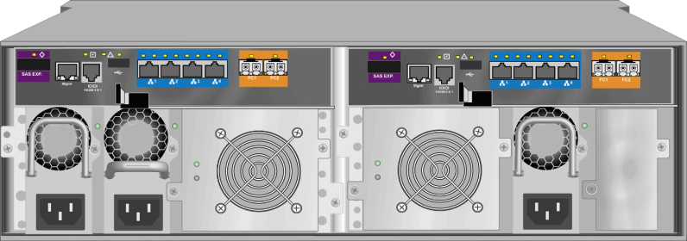
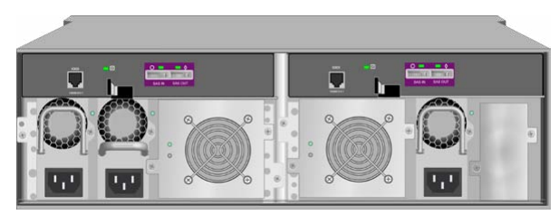
Product Specifications
Technology Specifications | DS600-G20 (Single Controller) |  | DS600-G20(Dual Controller)
Controller | Hot swap, single controller |  | Hot swap, dual redundant controller, Active-Active mode
Processor | 64-bit Multi-core processor
Cache | 2GB-16GB | 4GB-32GB
Cache Battery Protection | Lithium Battery
Flash Cache Protective Film Group | Standard configuration of permanent Cache-backup unit, no limitation for power-off time
Host Channel for Controller | 4x 1Gb ISCSI host interface, addition of 2x 10Gb ISCSI host interface and2x 8Gb FC host port available
Disk Channel | 4x SAS Disk Expansion Interface
RAID Level | 0, 1, 1E, 3, 5, 6, 10 (0+1), 30, 50, 60
Hot Spare | Overall and part hot standby supported, auto rebuild in RIAD backstage
Support Block Protocol | ISCSI, FC
Support File Protocol | SMB/CIFS, NFS, AFP, FTP, WebDAV
Support Share Disk | Authority management, Quota management, Online capacity expansion
Physical Characters
Maximum of Disk | Up to connect 6x JBOD, up to 112x disks
Disk Size Supported | 2TB, 3TB, 4TB(7200 RPM) 3.5” SATA / NL SAS, 600GB(15K RPM) 3.5” SAS, 120GB, 240GB, 480GB 2.5” SSD
Dimension | Standard 3U height 19 in rack(131x447x507mm)
Power, Fan | 2+1 redundant power, edundant fans, support online exchange
Net Weight | 20.1kg (no disk)
Noise | 55dB -75dB
Management Characters
Management Interface | Sugon RAID Management Software
Fault Alarm | Interface Alarm, sound-light alarm, E-mail alarm, SNMP
Logging | Real-time display of alarm logging, import and export, etc. supported
System Compatibility
Fiber Equipment Supported | LSI, Qlogic, Emulex, Brocade, etc.
OS Supported | Windows Server 2003/2008, Red Hat Linux 5.X/6.X, SUSE Linux Enterprise Server 10.X/11.X，Vmware ESX, etc. supported
Notes:
先讲整个IT行业的大背景

Slide 5
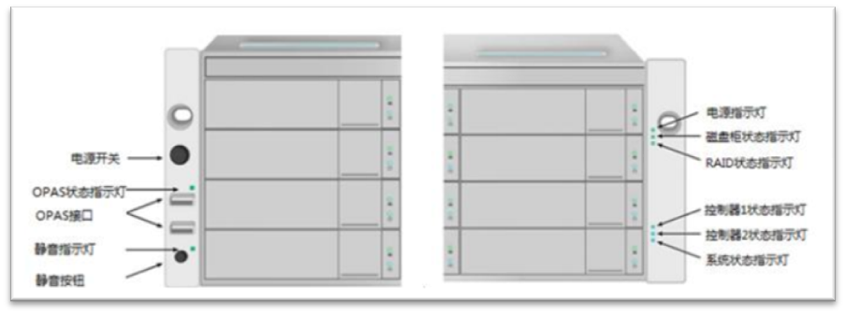
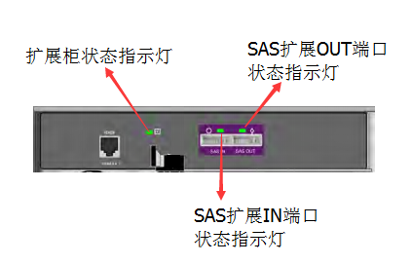
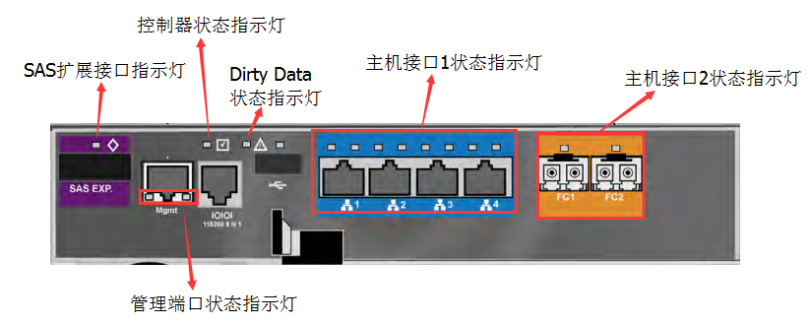
LED Indicator
Zhongke Sugon
Front Panel Light
Controller Light
Extended Cabinet
Light
Component Light
Power Module
Fan Module
BBU Battery
Power Light
Power
Disk Cabinet Status Light
RAID Status Light
OPAS Status Light
Controller 1 Status Light
OPAS Interface
Controller 2 Status Light
Mute Light
System Status Light
Mute Button
Disk Status Light
Power Status Light
Controller Status Light
Extended Cabinet Status Light
SAS Extended OUT Port
Status Light
SAS Extended Port Light
Dirty Data
Status Light
Host I/O 1 Status Light
Host I/O 2 Status Light
SAS Extended IN Port
Status Light
Port Management
Status Light
Notes:
先讲整个IT行业的大背景

Slide 6
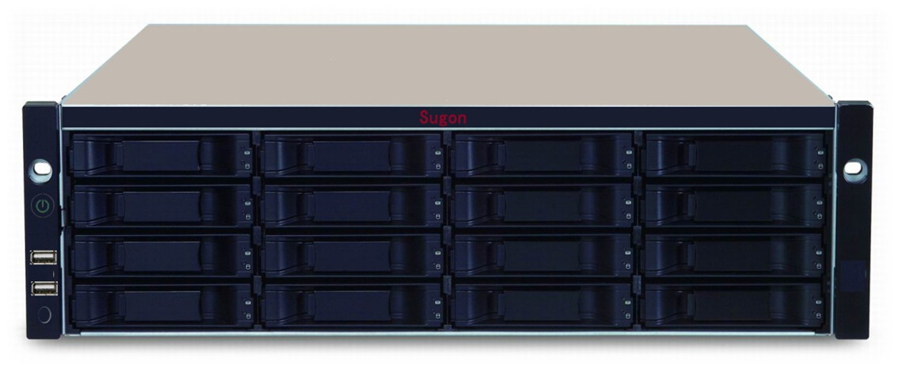
Front panel LED Lights
硬盘电源
电源
Disk Power
Power
机箱状态灯
硬盘状态
Case Status Light
Disk Status
Intelligent
Switch
RAID状态灯
智能开关
RAID Status Light
静音
智能管理口
控制器状态灯.
Mute
Intelligent Management Port
Controller Status Light
系统状态灯
System Status Light
控制器心跳灯
Controller Heartbeat Light
Notes:
先讲整个IT行业的大背景

Slide 7
Controller LED Lights
Controller Status Light
SAS Extended Port Light
Dirty Data
Status Light
Host I/O 1 Status Light
Host I/O 2 Status Light
Port Management
Status Light
LED Indicator | Instruction
SAS Extended Port Status Light | Green：Link Extended Cabinet
Port Management Status Light | LED light on the left shows that if there is connection： Off：no connection；Green：connect LED light on the right indicates port rate： Green：100Mbps
Controller Status Light | Green：Controller works
Dirty Cache Status Light | Amber：Dirty Data exist in the controller cache which is still not freshed into the disk Off：No Dirty Data
Notes:
先讲整个IT行业的大背景

Slide 8
Controller LED indicators
Host I/O of DS600-G20 includes 1Gb ISCSI、10Gb iSCSI、8Gb FC
LED Light | Instruction
1Gb ISCSI Port Status Light | LED Light on the left shows if there is connection： Off：no connected；Green：connected LED light on the right indicates ISCSI port rate： Amber：1000Mbps；Green：100Mbps
10Gb ISCSI Port Status Light | LED Light on the left shows if there is connection： Off：no connected；Green：connected LED light on the right indicates ISCSI port rate： Amber：10000Mbps；Green：1000Mbps
FC Port Status Light | Single LED light shows connection status and port rate via green and amber Green flashes slowly and amber flash at 4Hz indicate that connection is normal and rate is 8Gbps Green off：port abnormal
Notes:
先讲整个IT行业的大背景

Slide 9
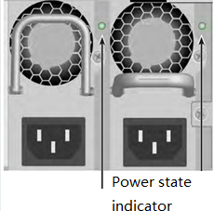
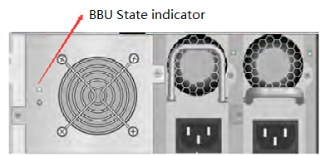
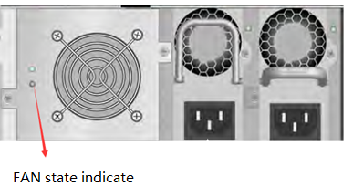
Component LED Lights
Power indicator
Green：Normal
Red：Power abnormal or component false
Fan indicator
Green：Normal
Red： component failure
BBU indicator
Green：Normal, full scale of energy
Amber ： on charge
Red：no battery or battery failure
Notes:
先讲整个IT行业的大背景

Slide 10
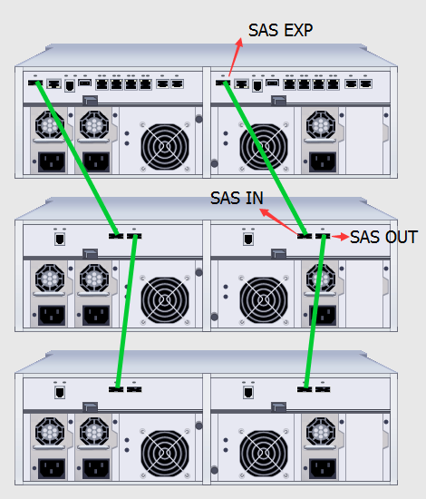
TopologicalLink
Notes:
先讲整个IT行业的大背景

Slide 11
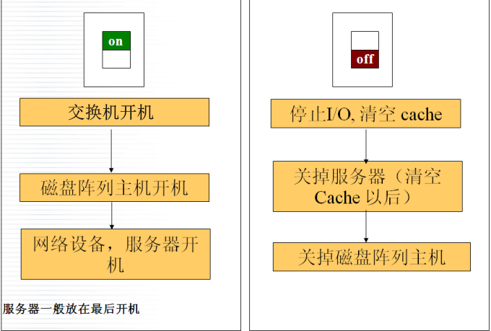
Order of boot and shutdown
Boot of storage system
Press the button on the front panel to start up, after the extension cabinet is connected, the main cabinet switch button to achieve the storage system of the switch machine.
Shutdown of storage system
Shutdown requires a long press switch button 5s, after the red indicator lights, the system will automatically save the data off the storage system.。
In the web management interface to close the storage
Switch Power
Stop I/O. empty cache
Disk array host boot
Turn off the server (after emptying Cache)
Network equipment, server boot
Turn off the disk array host
Server boot is generally in the last.
Notes:
先讲整个IT行业的大背景

Slide 12
Contents
1
DS600-G20 Overview
2
DS600-G20 Administration Configuration
3
DS600-G20 Maintenance
4
DS600-G20 FAQ
Notes:
先讲整个IT行业的大背景

Slide 13
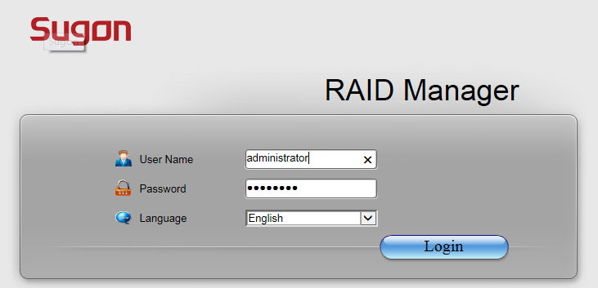
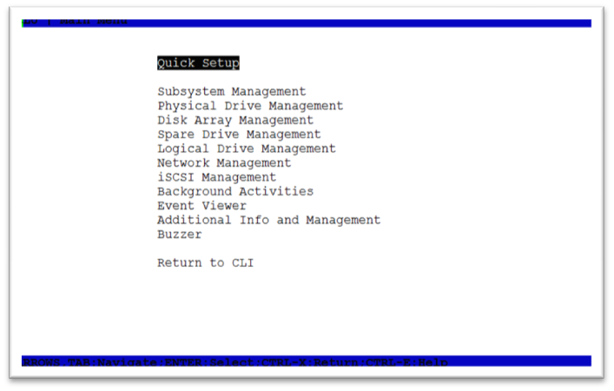
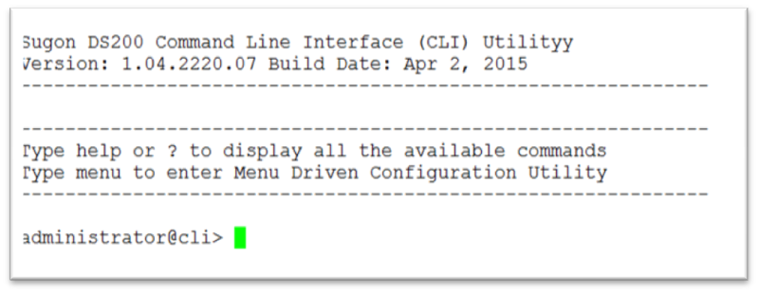
DS600-G20 management software
Web management interface
Browser access
Default management IP 10.0.0.1
CLI command line interface
Serial port, Telnet, SSH access
CLU command tool
Serial port, Telnet, SSH access
Notes:
先讲整个IT行业的大背景

Slide 14
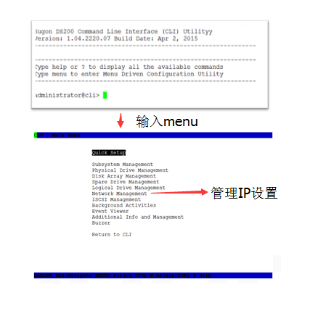
Serial Login
Serial type RJ11-DB9
Serial port parameter
Baud rate ：115200
Data bits ：8
Stop bit ：1
Parity check: no
Flow control: no
Username :administrator
Password :password
Common operations
View / modify management IP
Enter menu
Management IP settings
Notes:
先讲整个IT行业的大背景

Slide 15
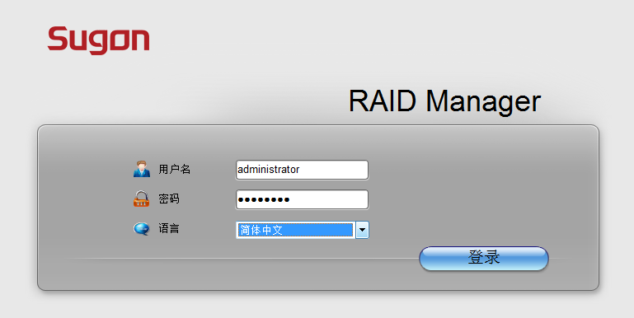
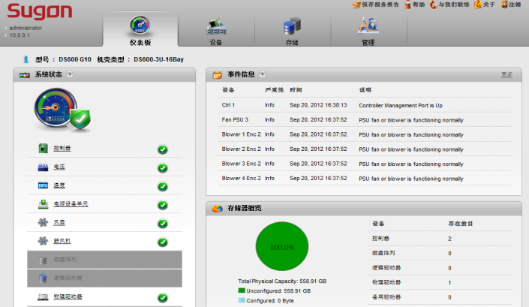
Web management software
Based on WEB management tool, compatible with mainstream browser
Chinese management configuration interface
Full graphical interface
The use of a built-in efficiency, performance monitoring management center
The default IP address ：10.0.0.1
Username ：administrator
Password：password
Notes:
先讲整个IT行业的大背景

Slide 16
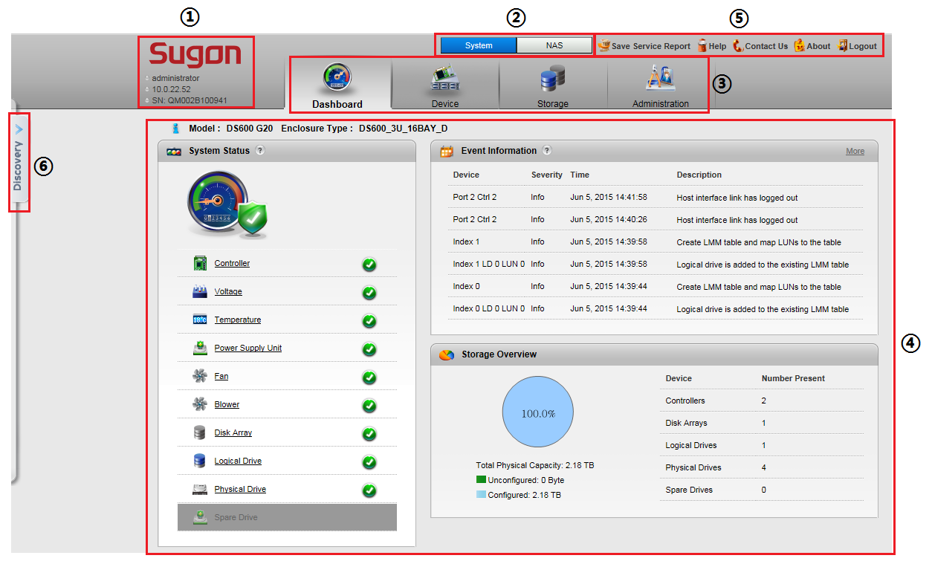
Web management software main interface
Notes:
先讲整个IT行业的大背景

Slide 17
Web management software main interface
Serial number | Name | Introductions
① | Login status display | Display the current IP address and the logged in user
② | Main function selection | Management software system, NAS two part feature set, [System] is mainly to provide a block device (DAS, SAN) disk array configuration and management capabilities overall monitoring [NAS] provides NAS management feature set, through button to switch to different functional configuration area .
③ | Navigation bar | [System] and [NAS] interface, each containing a number of configuration modules. [System] screen contains the [Dashboard], [Device], [Storage], [Administration] module; [NAS] interface contains [Dashboard], [File System], [Account], [Misc] module
④ | Display and configuration area | Display detailed information about navigation bar of each module, and provide configuration capabilities
⑤ | Service & Help | Including [Save Service Report], [Help], [Contac Us], [About], [Logout] button, etc.
⑥ | Discovery | Automatic discovery and automatically jump to the same management segment other storage devices
Notes:
先讲整个IT行业的大背景

Slide 18
iSCSI Configuration Process
Notes:
先讲整个IT行业的大背景

Slide 19
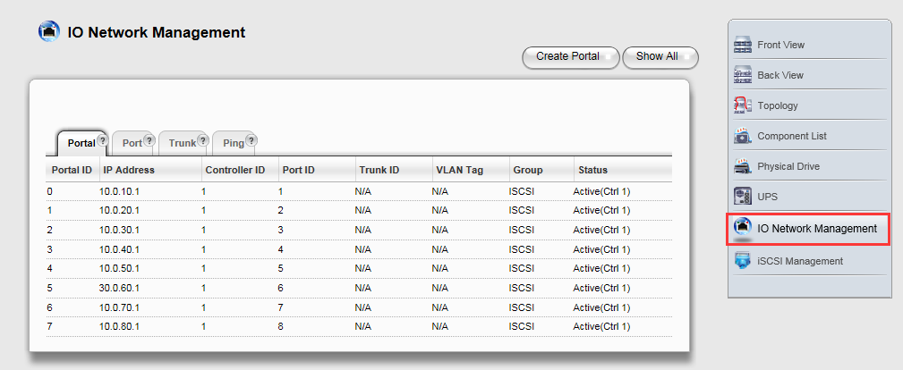
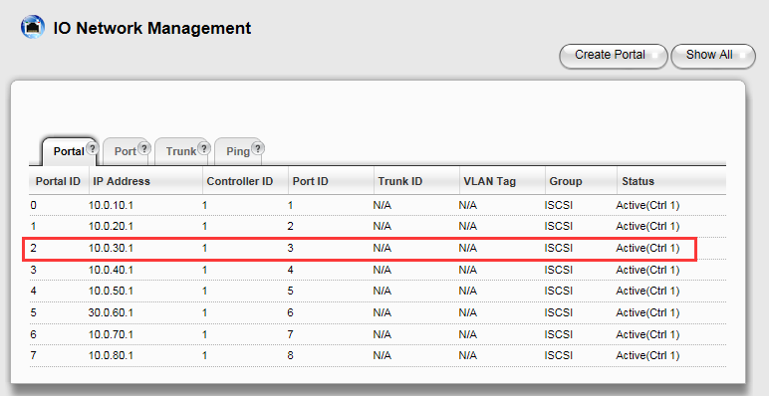
iSCSI Configuration
ISCSI network and software configuration
Create iSCSI entry
The application server is configured to keep the network connected to the iSCSI portal.
Application server to start iSCSI
Windows OS：iSCSI initiating program
Linux OS： iscsi or open-iscsi package
Notes:
先讲整个IT行业的大背景

Slide 20
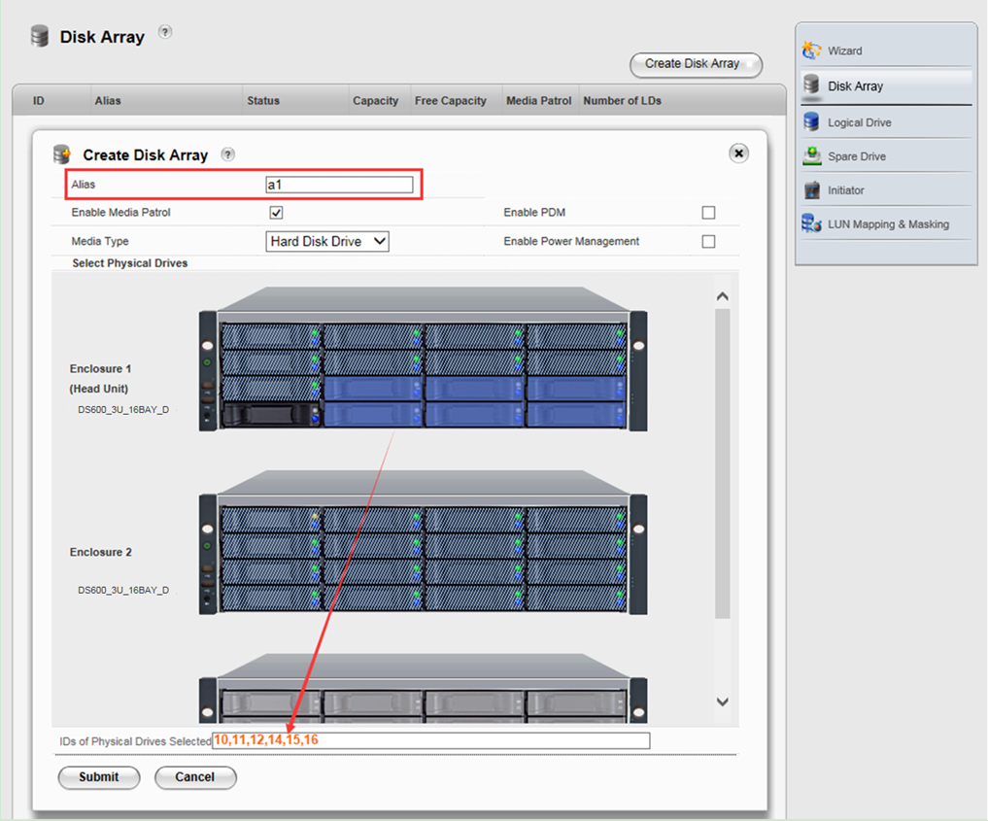
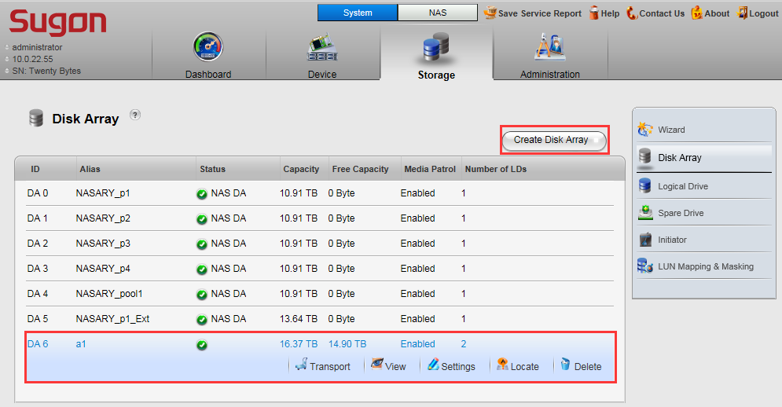
iSCSI Configuration
Create a storage space - create a disk array (DA)
Notes:
先讲整个IT行业的大背景

Slide 21
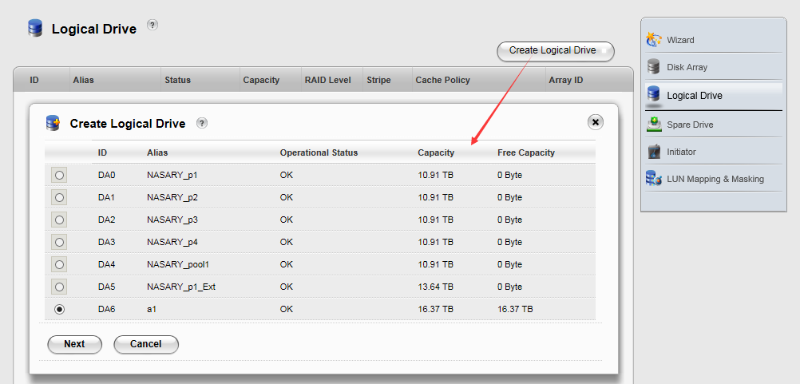
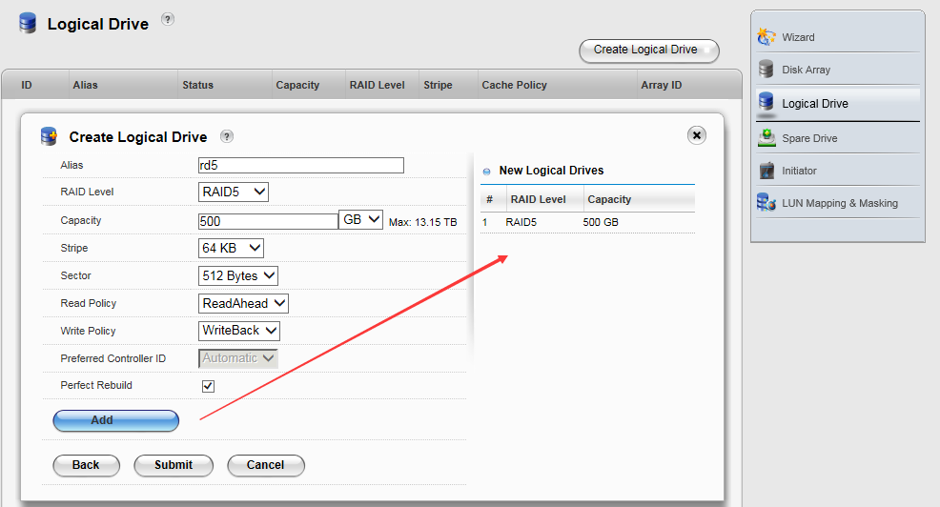
iSCSI Configuration
Create a storage space - create a logical disk (LD)
Notes:
先讲整个IT行业的大背景

Slide 22
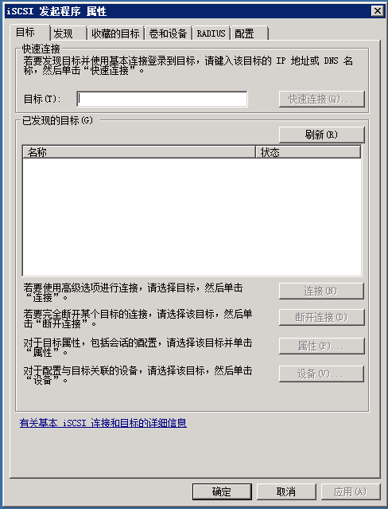
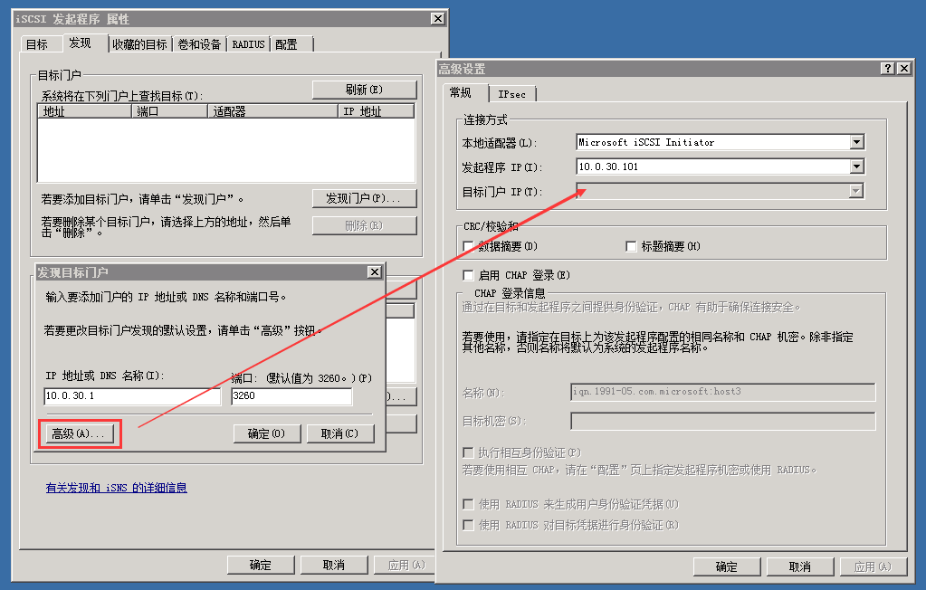
iSCSI Configuration
Establish a connection to the iSCSI configuration starter - add target portal
Notes:
先讲整个IT行业的大背景

Slide 23
iSCSI Configuration
Establish a connection to the iSCSI configuration to connect host starter - (Linux)
iscsiadm -m discovery -p 10.0.30.1 -t st
iscsiadm -m node -p 10.0.30.1 -l
Notes:
先讲整个IT行业的大背景

Slide 24
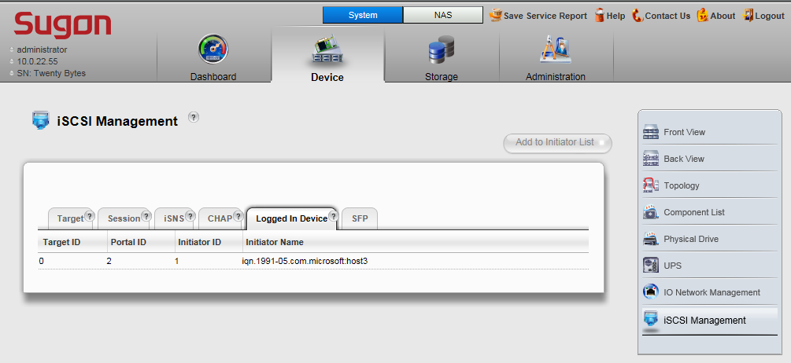
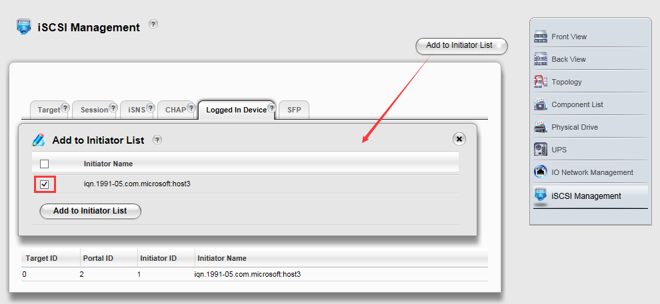
iSCSI Configuration
Establish a connection to the iSCSI - add a starter
Notes:
先讲整个IT行业的大背景

Slide 25
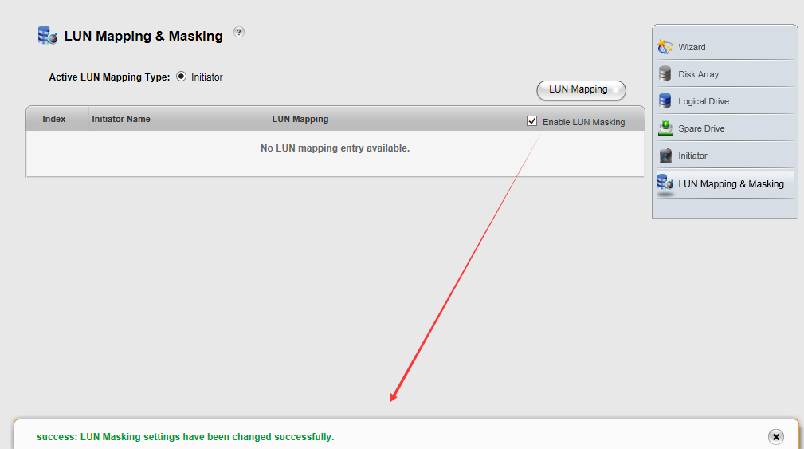
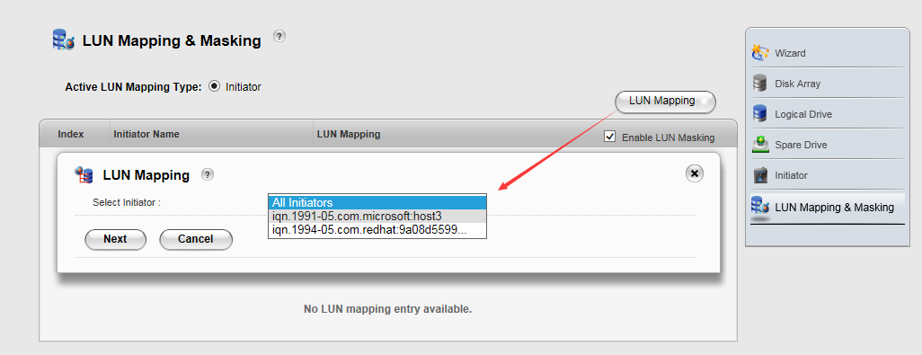
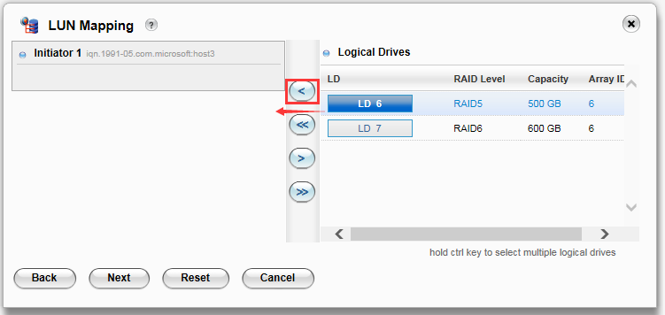
iSCSI Configuration
Establish iSCSI connection -LUN map
Notes:
先讲整个IT行业的大背景

Slide 26
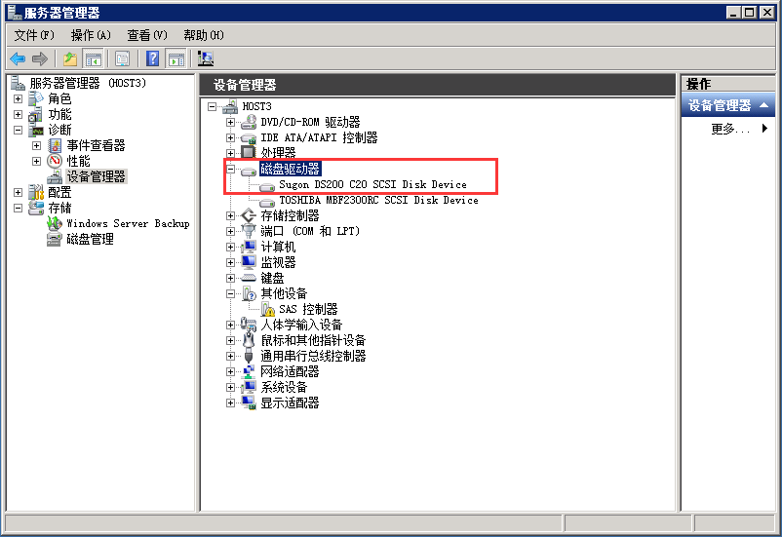
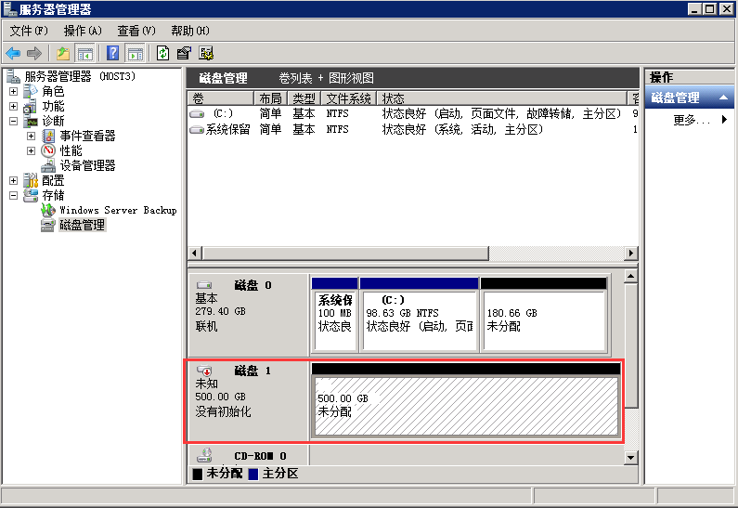
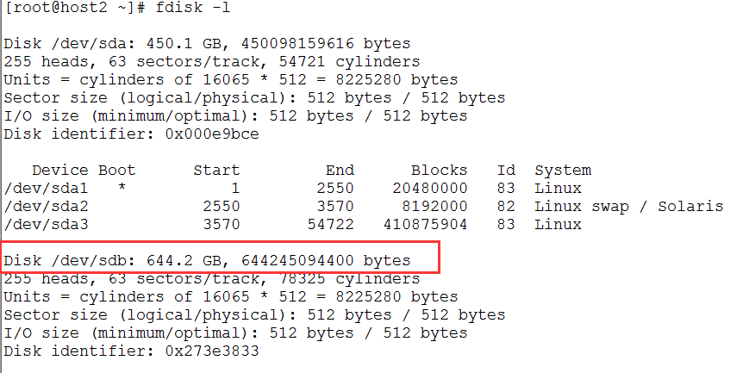
iSCSI Configuration
Application server to identify storage space
Notes:
先讲整个IT行业的大背景

Slide 27
FC Configuration Process
Start
FC link configuration
FC link configuration
Create disk array
Create storage space
Create logical disk
Configuration starter
LUN masking
Establish a connection
Yes
No
LUN mapping
Application server storage space
Identify storage space
End
Notes:
先讲整个IT行业的大背景

Slide 28
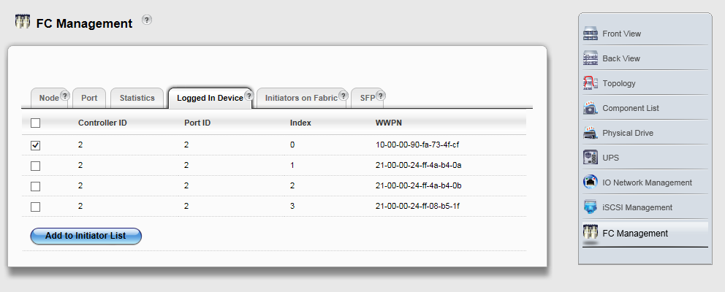
FC Configuration
FC Link Configuration
The application server FC HBA cards and FC disk array connected to the port, which can be directly connected or connected to FC switch connected after checking each FC port light is on.
Create storage space (see iSCSI configuration)
Create Disk Array （DA）
Create logical disks （LD）
Configure the FC starter
Notes:
先讲整个IT行业的大背景

Slide 29
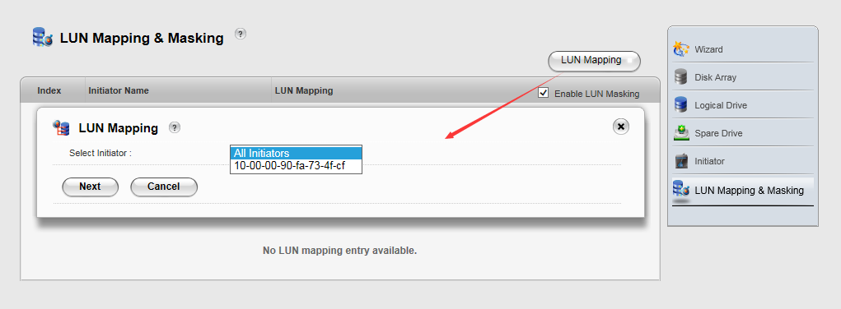
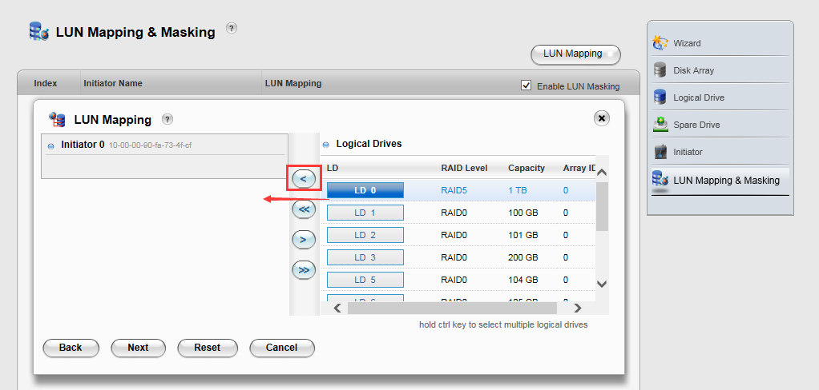
FC Configuration
LUN mapping
Notes:
先讲整个IT行业的大背景

Slide 30
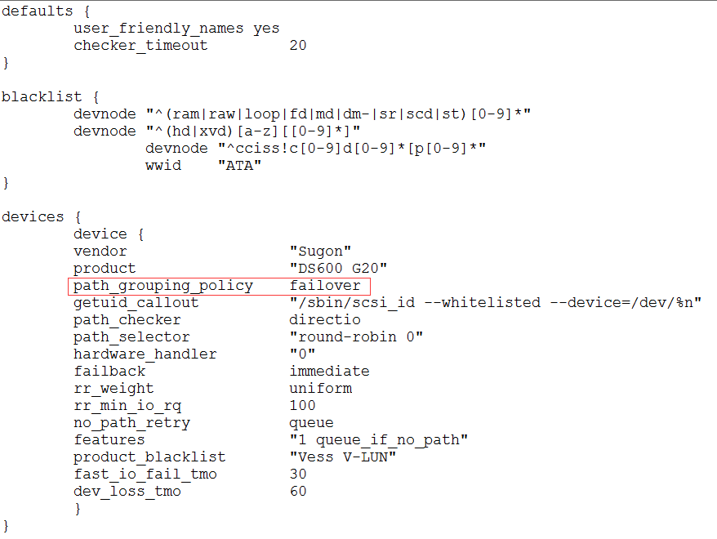
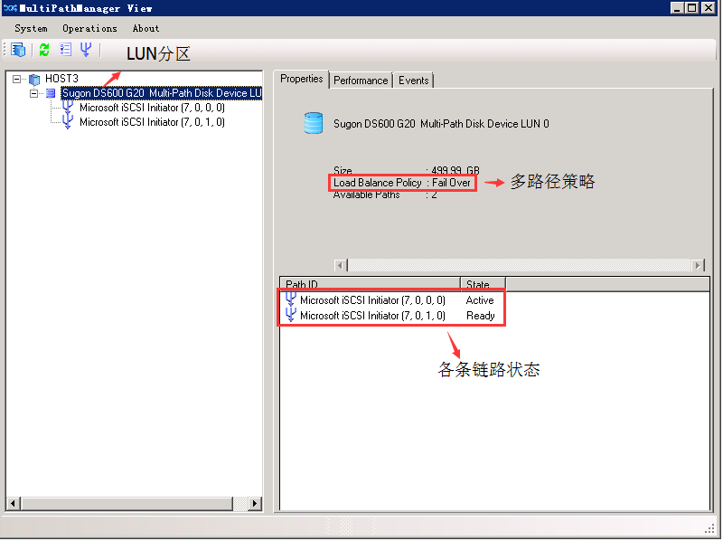
iSCSI/FC Multipath
Multipath Management Software
Windows Application Server ：Multipath Manager-[version] software
Linux Application Server ： The system comes with device-mapping-multipath software
Path redundancy strategy
Windows Application Server
Linux Application Server
Or round robin
Or multi bus
Notes:
先讲整个IT行业的大背景

Slide 31
NAS Configuration Process
Notes:
先讲整个IT行业的大背景

Slide 32
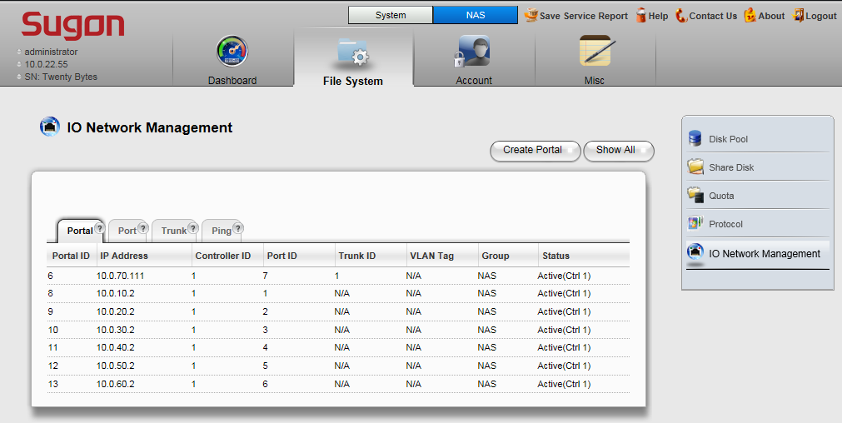
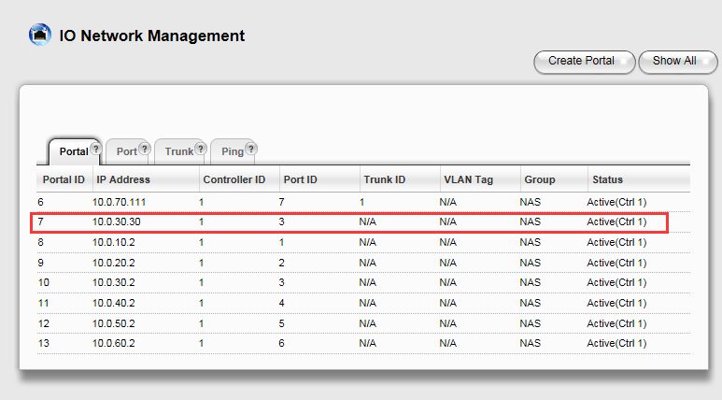
NAS Configuration
NAS Network Configuration
Notes:
先讲整个IT行业的大背景

Slide 33
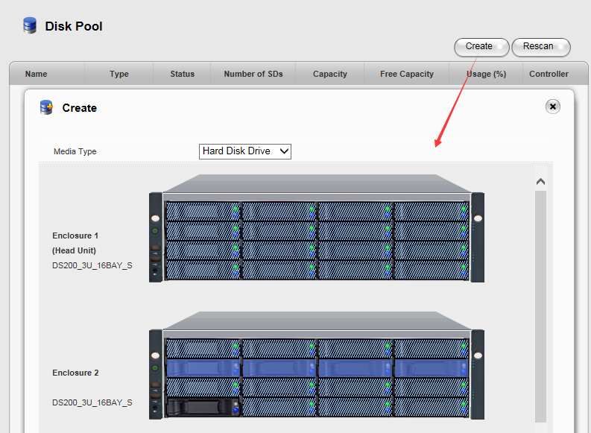
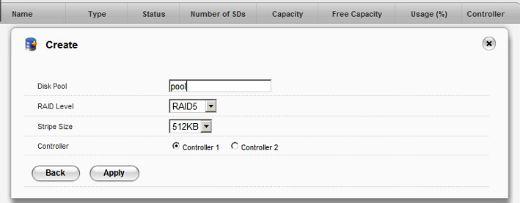
NAS Configuration
Creating a shared directory - creating a disk pool
Notes:
先讲整个IT行业的大背景

Slide 34
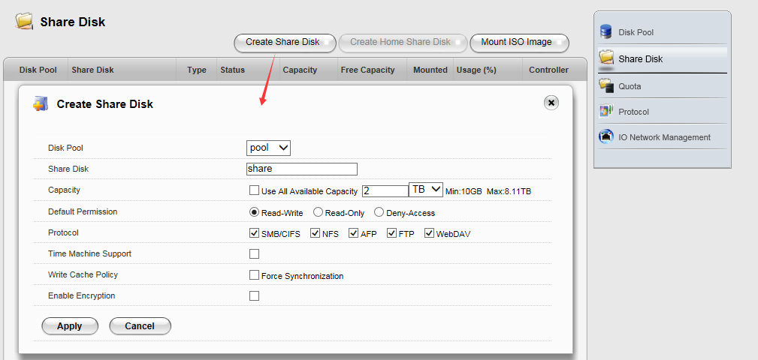
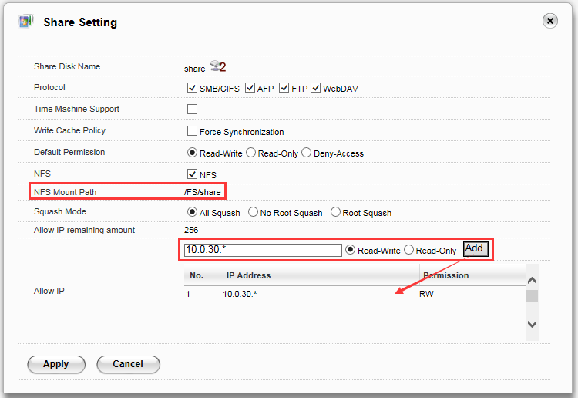
NAS Configuration
Creating a shared directory - creating a shared disk
Notes:
先讲整个IT行业的大背景

Slide 35
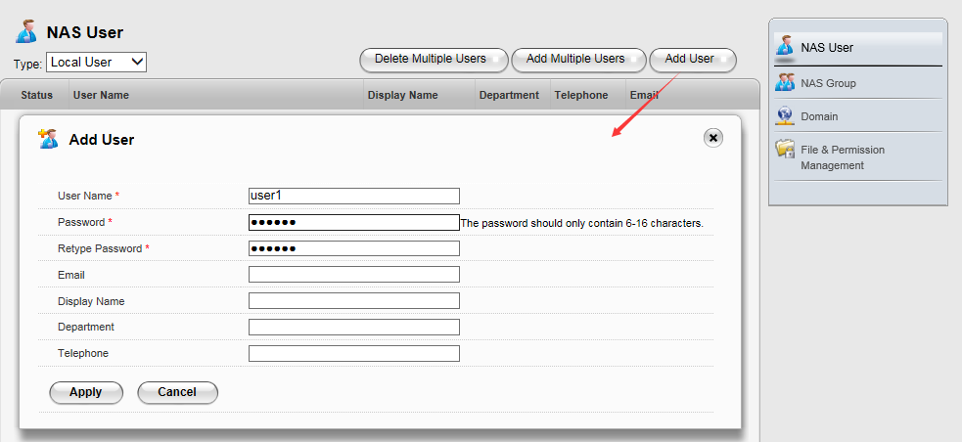
NAS Configuration
User Authentication - Local Users
Notes:
先讲整个IT行业的大背景

Slide 36
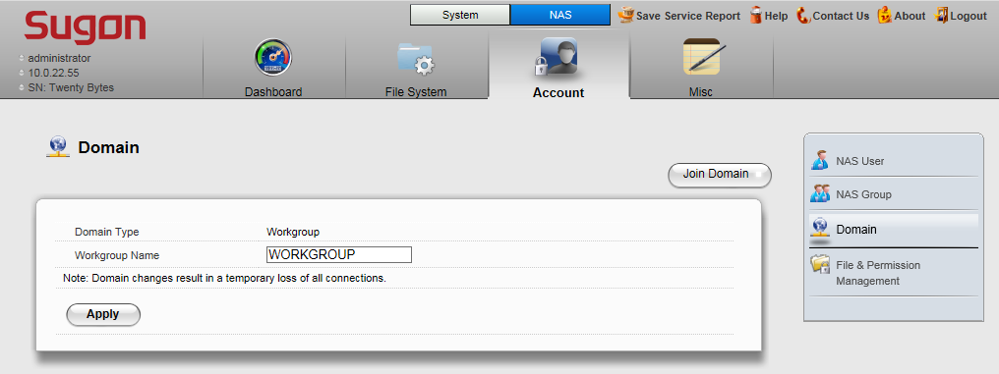
NAS Configuration
User Authentication - Domain User
Notes:
先讲整个IT行业的大背景

Slide 37
NAS Configuration
Setting quotas
Notes:
先讲整个IT行业的大背景

Slide 38
NAS Configuration
CHMOD
Notes:
先讲整个IT行业的大背景

Slide 39
NAS Configuration
NAS protocol access
CIFS
NFS
Notes:
先讲整个IT行业的大背景

Slide 40
Contents
1
DS600-G20 Overview
2
DS600-G20 Administration Configuration
3
DS600-G20 Maintenance
4
DS600-G20 FAQ
Notes:
先讲整个IT行业的大背景

Slide 41
Event Management
Level | Introductions
Fatal | There is an error in the system.
Critical | There is a serious problem that needs to be dealt with as soon as possible.
Major | Need to take some measures.
Minor | There are some problems, and some suggestions are proposed.
Warning | Users decide whether to take measures.
Information | System information, without taking any measures.
Notes:
先讲整个IT行业的大背景

Slide 42
System Troubleshooting
Ways of finding fault
Buzzer alarm sound;
All kinds of LED lights;
Regularly check [event management] in the event record, if the management of the user to enable the event notification, in accordance with the rules of the event will be notified in the form of e-mail users;
SNMP monitoring;
Application server business exception, etc.
Troubleshooting recommendations
Check the various types of LED lights;
To see if there are Fatal, Critical, Minor, Major, etc.
Notes:
先讲整个IT行业的大背景

Slide 43
Service report export
Service reports are used to analyze the underlying problems of the storage system, which can be used to export the service report in two ways when the failure is encountered.
Method 1 In the web administration interface, click [Save Service Report], the XX.zip saved locally.
Method 2 U flash disk is inserted into the OPAS interface of the front panel of the main cabinet, waiting for a few minutes, the service report will be automatically saved to the U flash disk.
Notes:
先讲整个IT行业的大背景

Slide 44
Contents
1
DS600-G20 Overview
2
DS600-G20 Administration Configuration
3
DS600-G20 Maintenance
4
DS600-G20 FAQ
Notes:
先讲整个IT行业的大背景

Slide 45
FAQ
After adding the AD domain, MAC OSis unable to access the SMB directory with the local user.
After adding the AD domain, OS MAC will be automatically added to the user name DOMIAN information, that is, the local user will become the form of DOMAI／username, and therefore can not be accessed by local users SMB.
LDAP domain server management
After adding the LDAP domain，
Local users can not be used, when the exit of the LDAP domain after the local users to continue to use；
Local users can not modify, add and delete；
Before setting the quota and permissions for local users will be cleared；
The user uid of the proposed LDAP server starts from 1000.
Notes:
先讲整个IT行业的大背景

Slide 46
FAQ
Maximum capacity of shared disk
The maximum capacity shared by the shared disk is related to the memory capacity of the controller.
Name limit for disk pool and shared disk
Not allowed to contain the following characters ：
.`~!@#$%^&*()+={}[]|\:;"'<>,?/ and blanks
Controller memory capacity | Shared disk allows maximum capacity
2GB | 8TB
4GB | 16TB
8GB | 32TB
16GB | 100TB
Notes:
先讲整个IT行业的大背景

Slide 47
FAQ
Local user /User group name restriction
The following characters are not allowed；
The maximum length is 30 bytes；
Can‘t be empty；
Reserved local users ："root", "daemon", "sshd", "nobody", "messagebus" and "administrator“
Reserved local user group： "root", "bin", "daemon", "sys", "adm", "tty", "disk", "mem", "kmem", "wheel", "uucp", "utmp", "rpcuser", "rpc", ntp", "ftp", "nobody", "users" ,"administrator“
Local user password restrictions
Allows a minimum number of characters to be 6, and the maximum number of characters is 16, and does not allow 'symbol and double byte characters (such as Chinese, etc.).
Notes:
先讲整个IT行业的大背景

Slide 48
FAQ
Whether can through the management port access to a Shared directory
Port management can be accessed through the shared directory, but if necessary, please use the data access port as soon as possible.
NFS mount directory
Mount directory is / FS / [share Disk Name], when that is in the shared directory must be mounted before the plus / FS /.
In the Windows operating system, how to clear the temporary log information for Samba users?
Enter under cmd：net use /delete *
Wait about 10s of time to re-login.
Notes:
先讲整个IT行业的大背景

